Slide 1
Unit 203: Electrical installations technology
Regulations

Slide 2
Regulations can be classified as follows:
statutory
non-statutory.

Slide 3
The Health and Safety at Work etc Act
A number of statutory Acts and Regulations were identified in Unit 201 under Health and Safety Executive (HSE) legislation.
Some of these are repeated here, along with others of which you will need to be aware.

Slide 4
The Electricity at Work Regulations
Require precautions to be taken against the risk of death or personal injury from electricity in work activities.
Electricity Safety, Quality and Continuity Regulations (ESQCR)
These cover the requirements for electricity supply in the United Kingdom.

Slide 5
Provision and Use of Work Equipment Regulations (PUWER)
Cover the supply and use of equipment in the workplace.
Equipment must be safe to use and used safely by the operatives.
Control of Substances Hazardous to Health Regulations (COSHH)
As the name suggests, these Regulations cover anything used in the workplace that could be considered hazardous to health.
This would include chemicals, asbestos, cements, oils, sprays, etc.

Slide 6
Construction (Design and Management) Regulations (CDM)
The Regulations place specific duties on clients, designers and contractors to rethink their approach to health and safety so that it is taken into account throughout the life of a construction project, from its inception to its subsequent final demolition and removal.
Manual Handling Operations Regulations (MHOR)
These Regulations aim to reduce the very large incidence of injury and ill health caused by the manual handling of loads at work.

Slide 7
Personal Protective Equipment at Work Regulations (PPEWR)
Require an assessment of PPE requirements to be carried out.
Employer to supply the PPE.
Employee to wear the protective equipment.
Control of Noise at Work Regulations
Place a duty on employers within Great Britain to reduce the risk to their employees’ health by controlling the noise they are exposed to whilst at work.
Everyone at work could be exposed to noise and suffer temporary or permanent hearing loss.
Require employers to eliminate or reduce noise levels.

Slide 8
Environmental Act
This is an Act of the Parliament that defines the fundamental structure and authority for waste management and control of emissions into the environment.

Slide 9
Disability Discrimination Act (DDA)
This has now been repealed and replaced by the Equality Act 2010 (except in Northern Ireland where the Act still applies).
Formerly, it made it unlawful to discriminate against people because of their disabilities in relation to employment, the provision of goods and services, education and transport.
Equality Act
Requires equal treatment in access to employment, as well as private and public services, regardless of age, disability, gender reassignment, marriage and civil partnership, race, religion or belief, sex and sexual orientation.

Slide 10
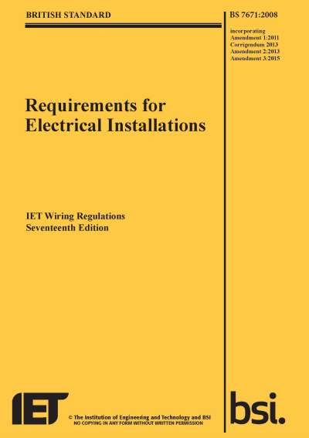
Requirements for Electrical Installations (BS 7671)
Published by the IET, these are the national standard in the United Kingdom for low voltage electrical installations.
These regulations have closely followed the corresponding international standard IEC 60364.
Based on the European Committee for Electrotechnical Standardization (CENELEC) harmonization document.
In 1992, the IEE Wiring Regulations became British Standard BS 7671.
Non-statutory.

Slide 11
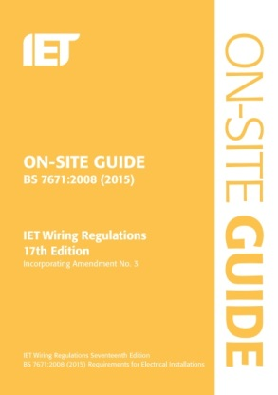
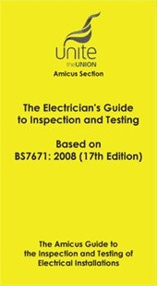
On‑Site Guide
Handbook that contains some information not in BS 7671
Handy notebook reference for electricians.
Unite Union Book
Published by the trade union ‘Unite’.
Contains a wealth of information for the practising electrician.
Based on BS 7671.

Slide 12
IET Guidance Notes
The IET issues a number of Guidance Notes based on different topics. They provide additional clarification on how to implement and comply with BS 7671. Current titles are:
Guidance Note 1: Selection and Erection, 7th Edition
Guidance Note 2: Isolation and Switching, 7th Edition
Guidance Note 3: Inspection and Testing, 7th Edition
Guidance Note 4: Protection Against Fire, 7th Edition
Guidance Note 5: Protection Against Electric Shock, 7th Edition
Guidance Note 6: Protection Against Overcurrent, 7th Edition
Guidance Note 7: Special Location, 5th Edition
Guidance Note 8: Earthing and Bonding, 3rd Edition.

Slide 13
Unit 203: Electrical installations technology
The End

